Slide 1

MINI PROJECT
NAME : YOGESH WARAN. S
ROLL NO :RA2111004010448
TOPIC : AGE CALCULATOR
Simple Fresh Template
A designer can use default text to simulate what text would look like. It looks even better with you using this text. Whoever evaluates your text cannot evaluate the way you write. Your design looks awesome by the way.
Time：XX.XX.

Slide 2
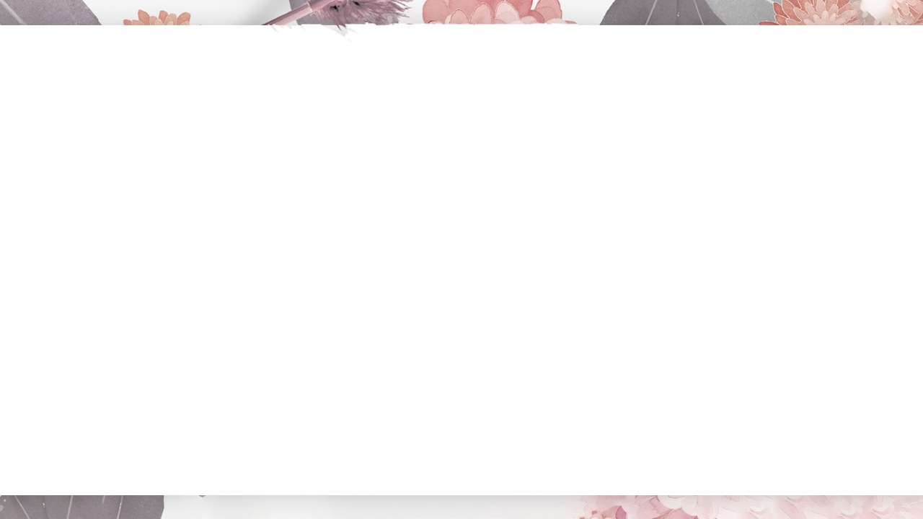
ADD TITLE HERE
01.
#include <stdio.h> #include <stdlib.h> // function to calculate current age void age(int present_date, int present_month, int present_year, int birth_date, int birth_month, int birth_year) { int month[] = { 31, 28, 31, 30, 31, 30, 31, 31, 30, 31, 30, 31 }; if (birth_date > present_date) { present_date = present_date + month[birth_month - 1]; present_month = present_month - 1; }
#include <stdio.h> #include <stdlib.h> // function to calculate current age void age(int present_date, int present_month, int present_year, int birth_date, int birth_month, int birth_year) { int month[] = { 31, 28, 31, 30, 31, 30, 31, 31, 30, 31, 30, 31 }; if (birth_date > present_date) { present_date = present_date + month[birth_month - 1]; present_month = present_month - 1; }
#include <stdio.h> #include <stdlib.h> // function to calculate current age void age(int present_date, int present_month, int present_year, int birth_date, int birth_month, int birth_year) { int month[] = { 31, 28, 31, 30, 31, 30, 31, 31, 30, 31, 30, 31 }; if (birth_date > present_date) { present_date = present_date + month[birth_month - 1]; present_month = present_month - 1; }

Slide 3


ADD TITLE HERE
01.
if (birth_month > present_month) { present_year = present_year - 1; present_month = present_month + 12; } int final_date = present_date - birth_date; int final_month = present_month - birth_month; int final_year = present_year - birth_year; printf("Present Age Years: %d Months: %d Days: %d",
No one indebted for others,while many people don't know how to cherish others.
No one indebted for others,while many people don't know how to cherish others.
ADD TITLE HERE
No one indebted for others,while many people don't know how to cherish others.No one indebted for others,while many people don't know how to cherish others.
ADD TITLE HERE
No one indebted for others,while many people don't know how to cherish others.No one indebted for others,while many people don't know how to cherish others.

Slide 4


20XX
} int main() { int present_date = 21; int present_month = 9; int present_year = 2019; int birth_date = 25; int birth_month = 9; int birth_year = 1996; age(present_date, present_month, present_year, birth_date, birth_month, birth_year); return 0; }
01.
20XX
ADD TITLE HERE
promising future
Click here to add the text, the text is the extraction of your thought, please try to explain the point of view as succinctly as possible.
promising future
Click here to add the text, the text is the extraction of your thought, please try to explain the point of view as succinctly as possible.

